Slide 1

Utilizing population-based studies (GWAS) to understand common diseases
Shweta Ramdas
Centre for Brain Research (CBR)
shwetaramdas@iisc.ac.in

Slide 2
Genetic variation in human populations
Allele frequency in the population
 | Common | Rare
Coding
Non-coding
Genomic
Context

Slide 3
Genetic variation in human populations
Allele frequency in the population
 | Common | Rare
Coding | GWAS | Exome sequencing studies
Non-coding | GWAS | Genome sequencing + functional readouts
Genomic
Context
GWAS: Genomewide association studies

Slide 4
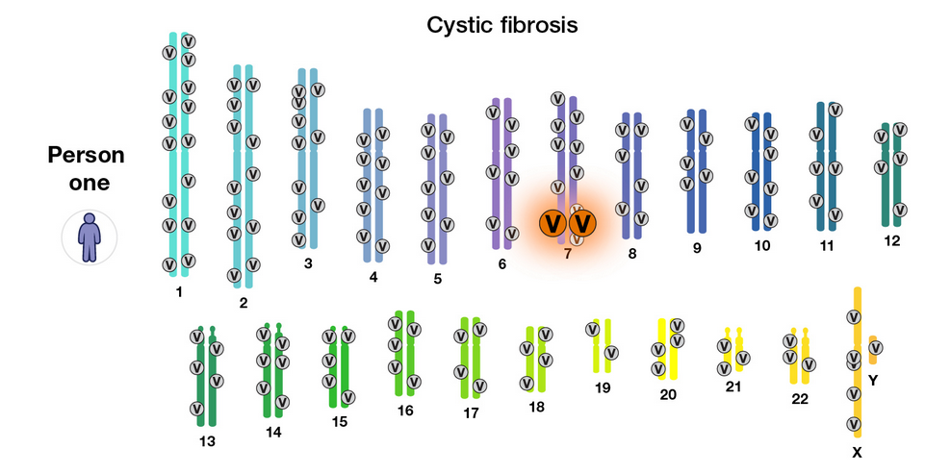
What diseases do we study?
Mendelian: One gene-one disease
Complex trait: many genes + environment = disease
Different people with the same trait may have different causal factors
Image Credit: NIH

Slide 5
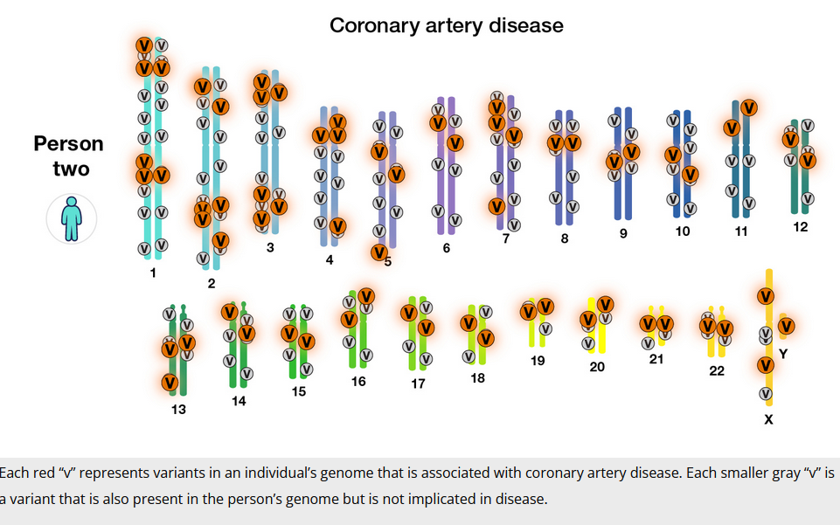
Complex diseases are multi-factorial: no single cause
Image Credit: NIH

Slide 6

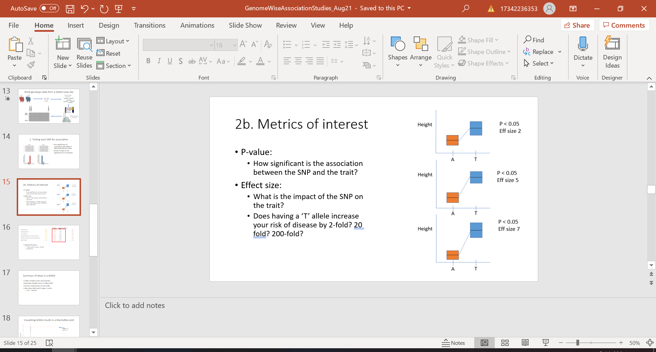
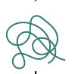
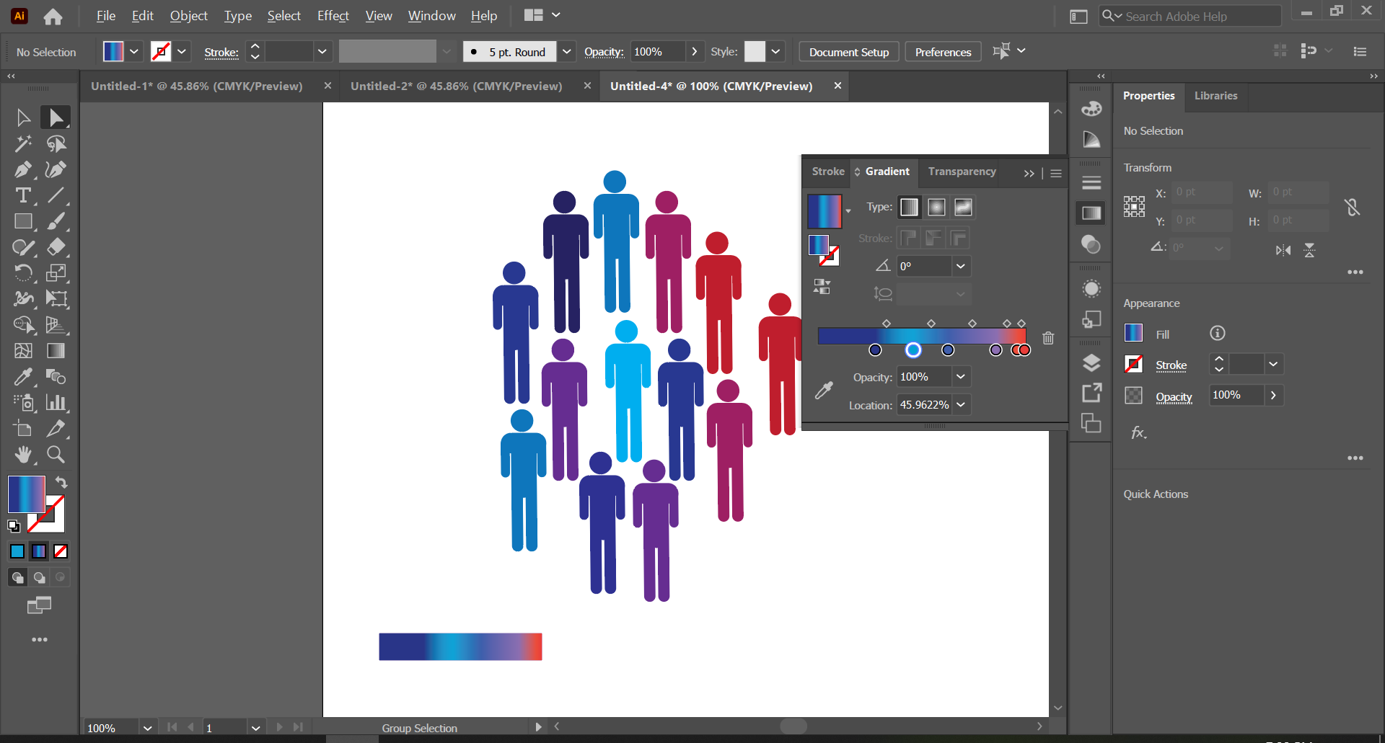
Genomewide Association Studies (GWAS)
Testing 1 million positions in the genome for association with phenotype
Phenotype
Genotype each person at 1 million positions in the genome
Genotype
Phenotype gradient
SNP/Variant = Single nucleotide polymorphisms in the genome

Slide 7
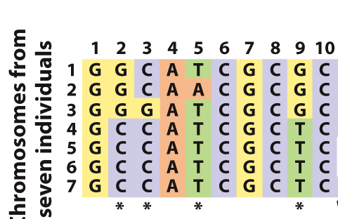
Defining genetic variation in the human genome
Human genome is 3 billion bases long
Genetic variant: any position in the genome that commonly varies among individuals
Single Nucleotide Polymorphism (SNP)
Allele frequency > 1-5%
Allele: The nucleotides at a given genetic variant
Genotype: The nucleotides an individual carries at a given position

Slide 8
Do we test all positions in the genome for association with the disease?
Sequencing every position in the genome is expensive
Can we select a subset of positions to test?

Slide 9
Genetic recombination and linkage
Mother
Father
Offspring
Offspring gets a mosaic of the two maternal chromosomes, and a mosaic of the two paternal chromosomes
Physically close locations in a genome have similar genotypes across individuals
They ‘travel together’ in individuals
Notes:
Add a couple of example SNPs

Slide 10
Genetic recombination and linkage
Mother
Father
Offspring
A
B
C
Offspring gets a mosaic of the two maternal chromosomes, and a mosaic of the two paternal chromosomes
Physically close locations in a genome have similar genotypes across individuals
They ‘travel together’ in individuals
Notes:
Add a couple of example SNPs

Slide 11
Linkage allows us to use ‘tag SNPs’
Can use a single marker as a ‘signpost’ for an entire region
These signposts are called ‘tag SNPs’
We use 1 million tag SNPs in GWAS
0.03% of the total genome
Tag SNP
Notes:
Title doesn’t fit. Change to merge bettwe with previous slide.
Arrow showing tag SNPs, and the region around each. Also say, what the block is (maybe a small chun of chromosome 19)

Slide 12
Linkage allows us to use ‘tag SNPs’
Can use a single marker as a ‘signpost’ for an entire region
These signposts are called ‘tag SNPs’
We use 1 million tag SNPs in GWAS
0.03% of the total genome
Actual causal variant is in this region
Tag SNP
Notes:
Title doesn’t fit. Change to merge bettwe with previous slide.
Arrow showing tag SNPs, and the region around each. Also say, what the block is (maybe a small chun of chromosome 19)

Slide 13
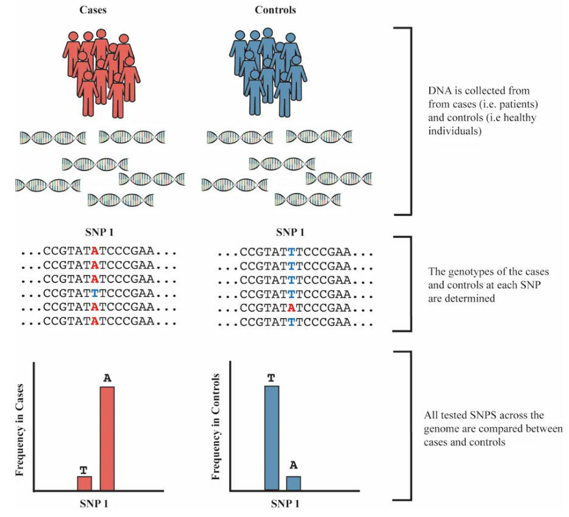
What data from a GWAS looks like

Slide 14
What data from a GWAS looks like
Collect DNA from each sample

Slide 15
What data from a GWAS looks like
Fragment DNA into pieces
Collect DNA from each sample

Slide 16
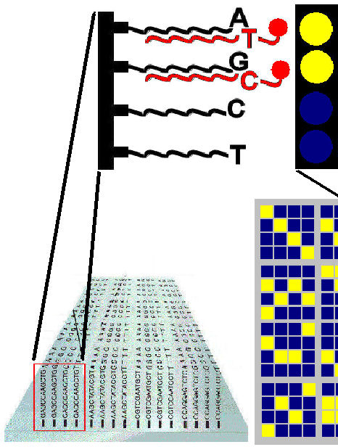
What data from a GWAS looks like
Fragment DNA into pieces
Collect DNA from each sample
Genotype with microarray chip:
Each spot tests one SNP

Slide 17
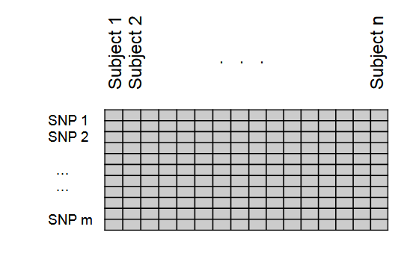
What data from a GWAS looks like
Fragment DNA into pieces
Collect DNA from each sample
Genotype with microarray chip:
Each spot tests one SNP

Slide 18
2. Testing each SNP for association
Notes:
SNP1: two alleles are A and T. A is found more often in cases, and T is found more often in controls. Explicitly say you do this m times, for a million SNPs

Slide 19
2. Testing each SNP for association
Test significance of association with allele at SNP1 with disease status
Logistic/linear model
Check P-value to test significance of association
P < 0.05 : significant
P > 0.05 : model is not significant
Notes:
SNP1: two alleles are A and T. A is found more often in cases, and T is found more often in controls. Explicitly say you do this m times, for a million SNPs

Slide 20
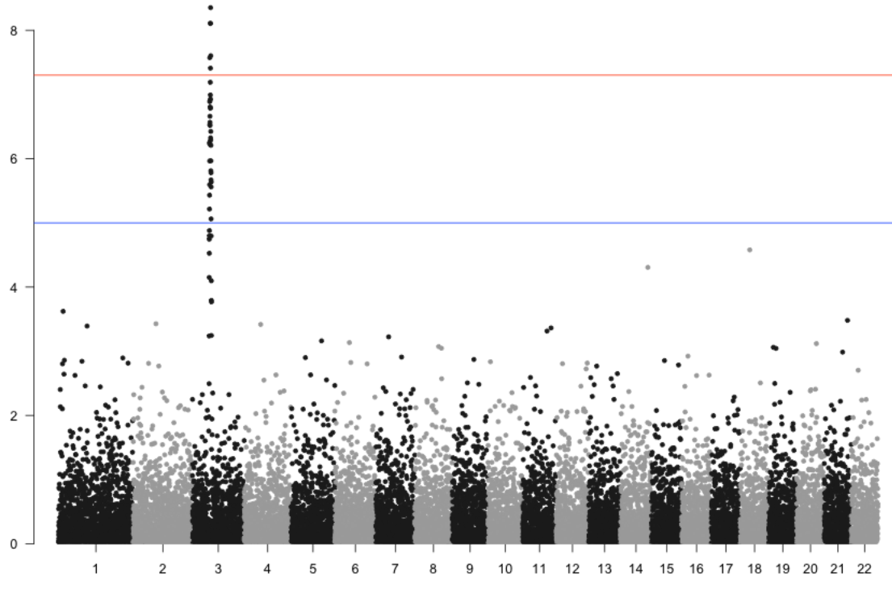
Visualizing GWAS results in a Manhattan plot
Threshold for significance
(P < 5e-08)
Significance :-log10(pvalue
Each point on the plot = 1 SNP
Chromosome

Slide 21
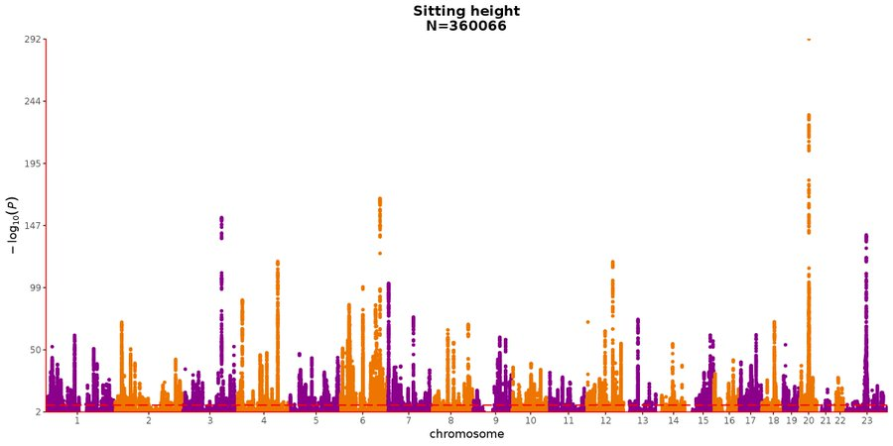
GWAS of height shows signals across the genome
Y-axis represents significance, the higher the more significant
Sample size of gwas
Threshold for significance
(P < 5e-08)

Slide 22
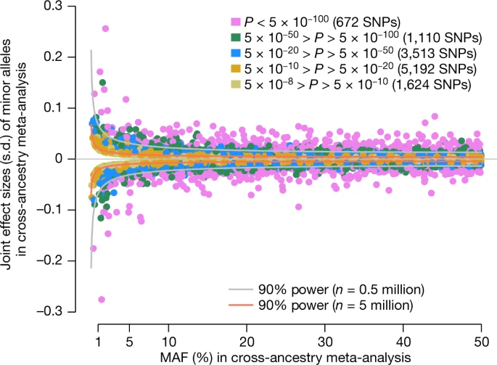
Yengo et al, 2022

Slide 23
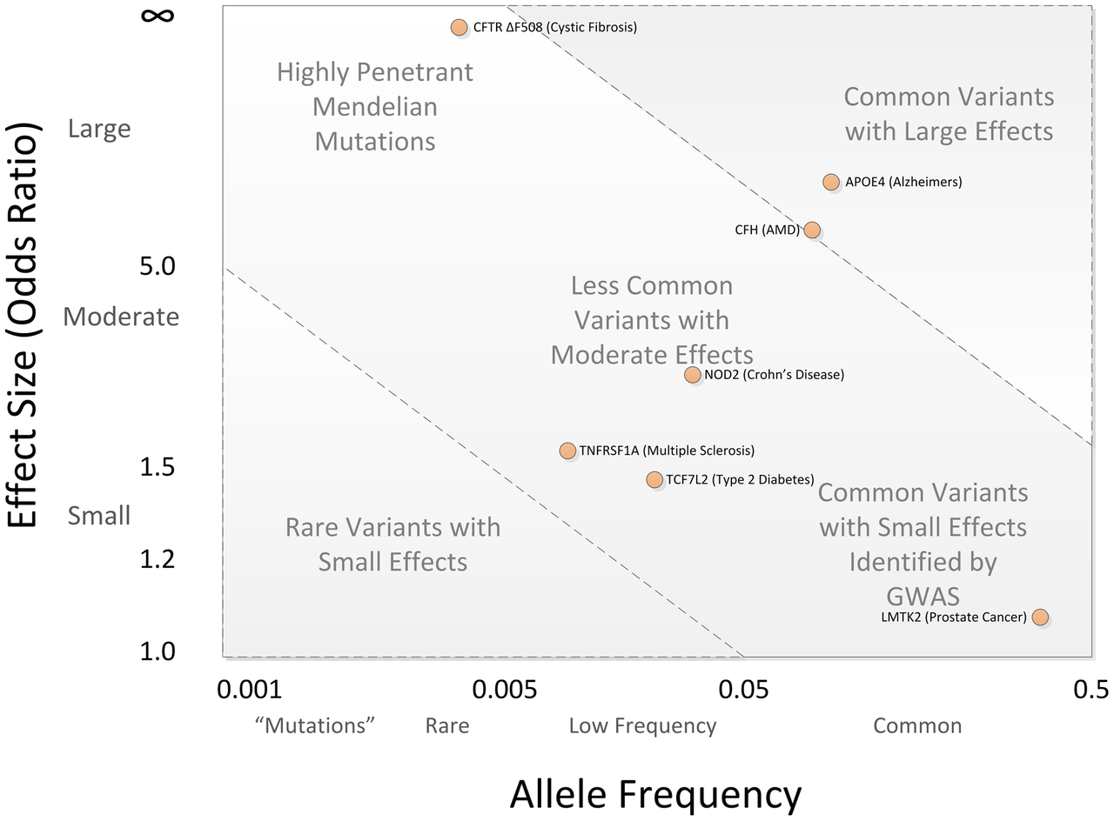
What GWAS can/cannot find
Common variants with large effect
Effect on disease
Common variants with small effect (GWAS)

Slide 24
What GWAS can/cannot find
Rare variants with large effects
Common variants with large effect
Effect on disease
Rare variants with small effects
Common variants with small effect (GWAS)

Slide 25
GWAS sample size
Small effect sizes require large sample sizes
Largest GWAS for height included 5 million samples
Lipid levels : 1.3 million samples
Alzheimer’s: ~80,000-100,000 cases
Small sample sizes may work with
‘low-hanging fruit’ signals
phenotypes that are close to biology

Slide 26
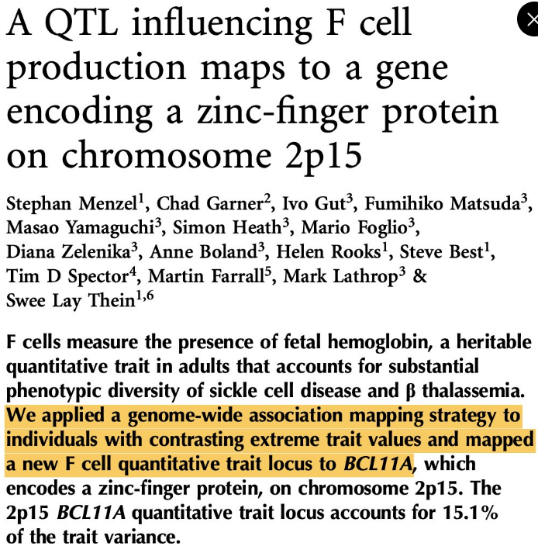
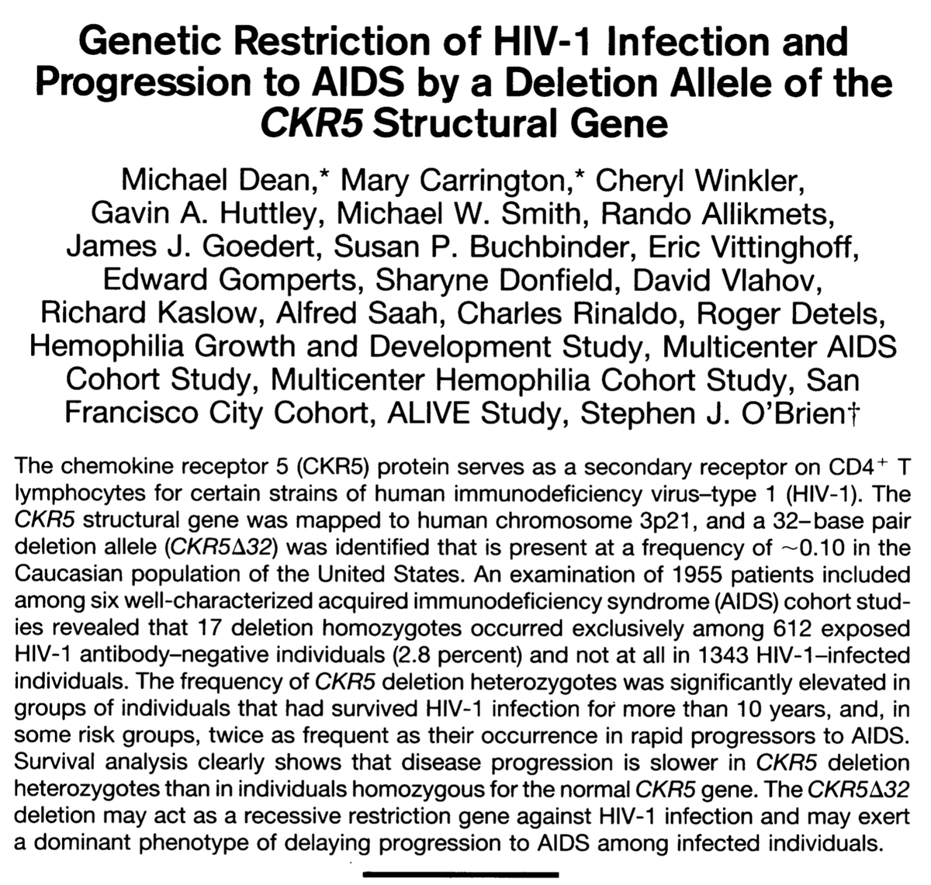

Slide 27
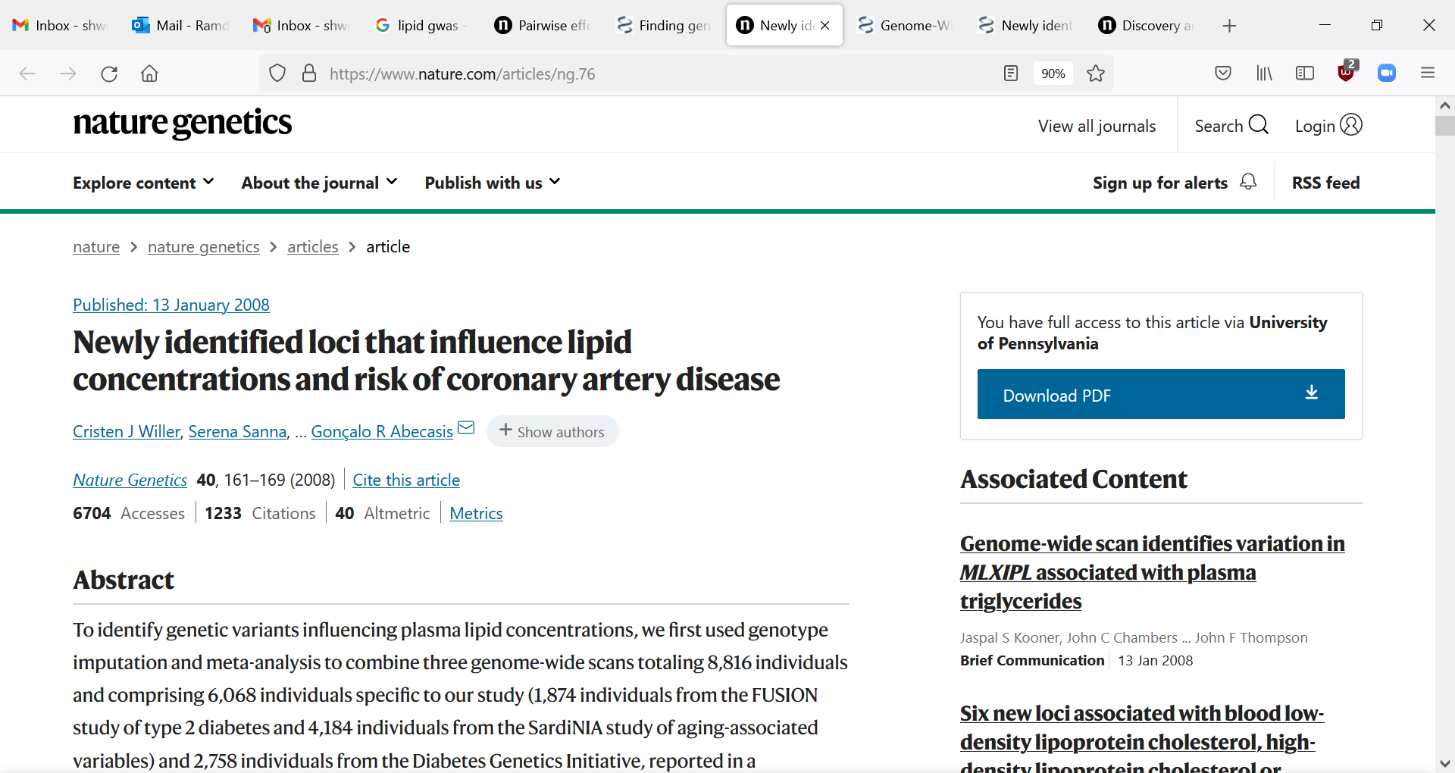
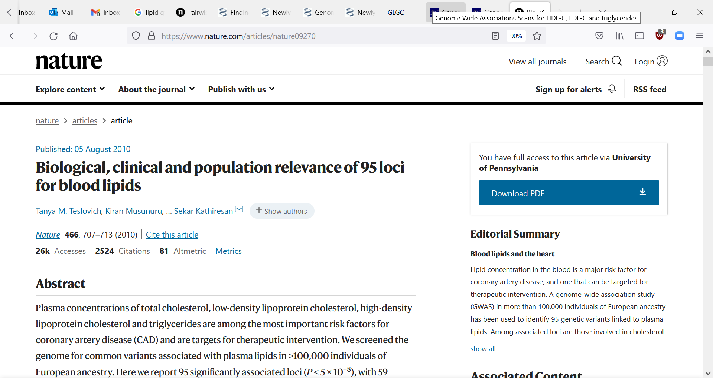
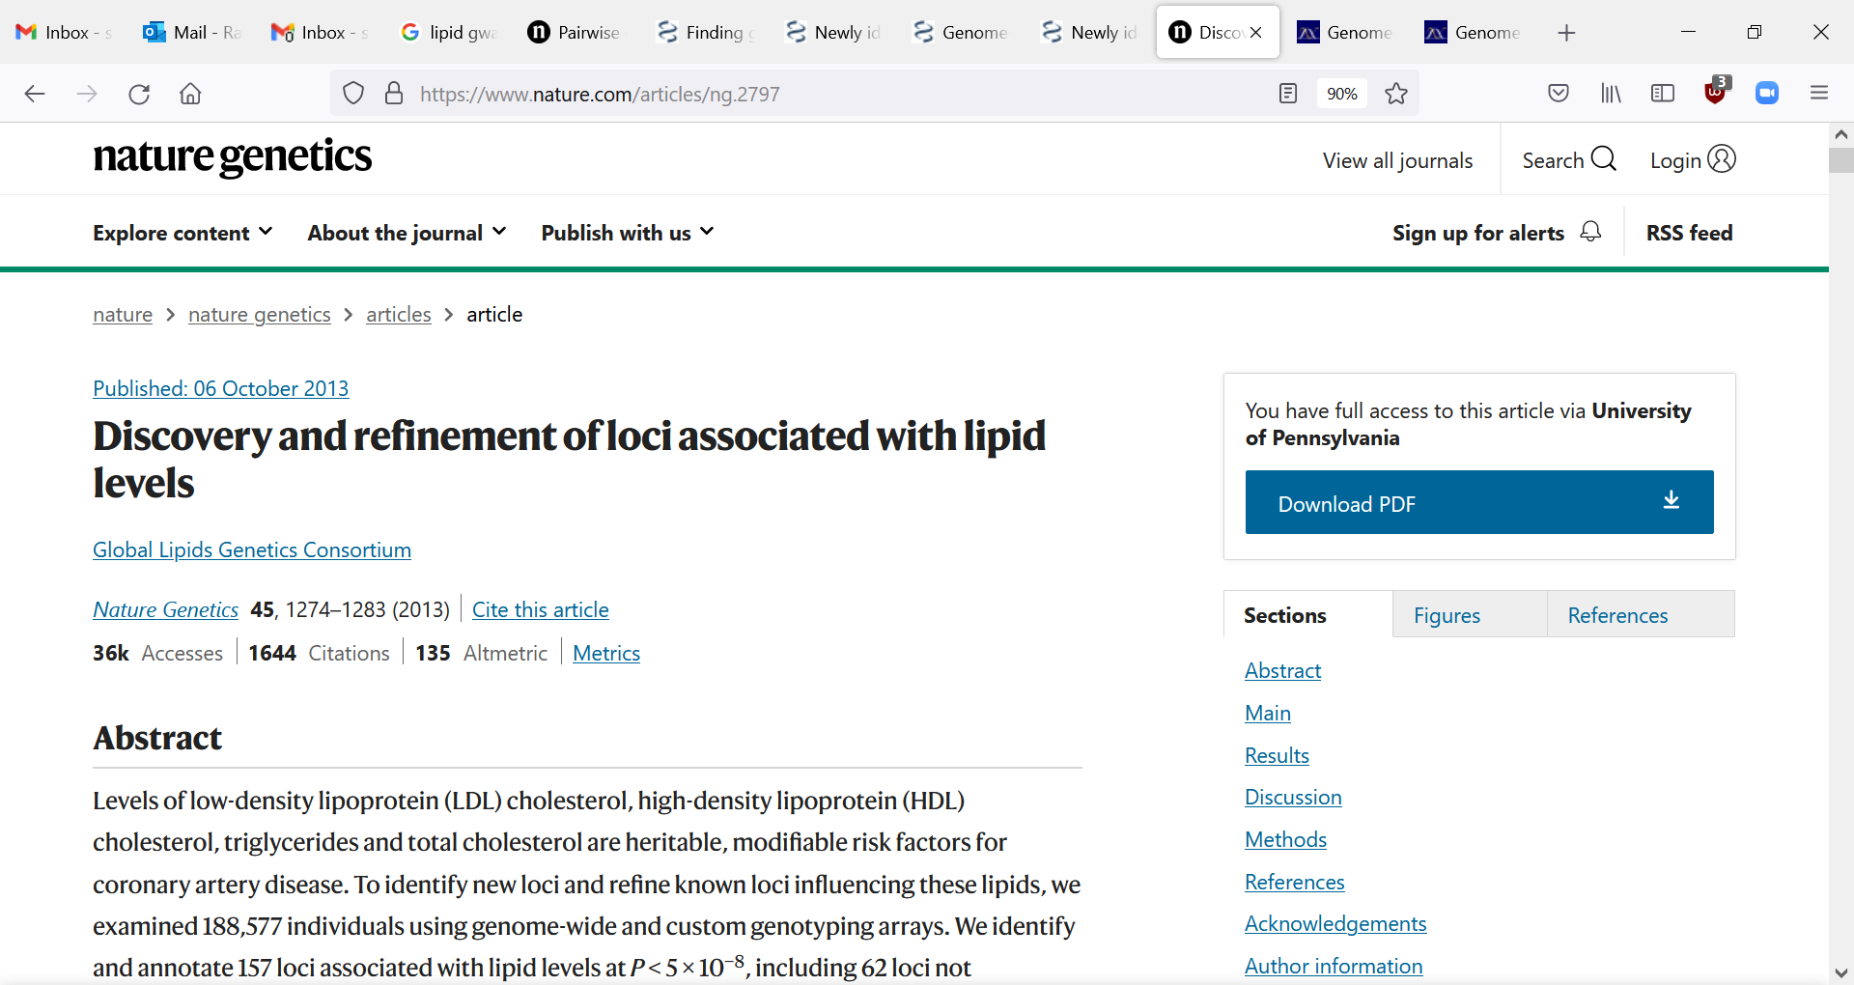
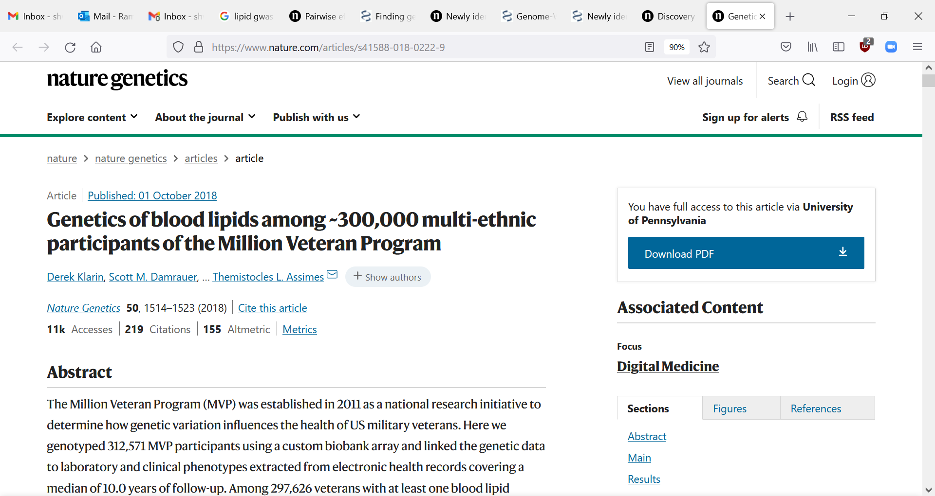
History of lipid GWAS
8,816 European samples
18 lipid-associated loci
>100,000 European samples
95 lipid-associated loci
188,577 European samples
157 lipid-associated loci
300,000 multi-ancestry samples
> 250 lipid-associated loci

Slide 28
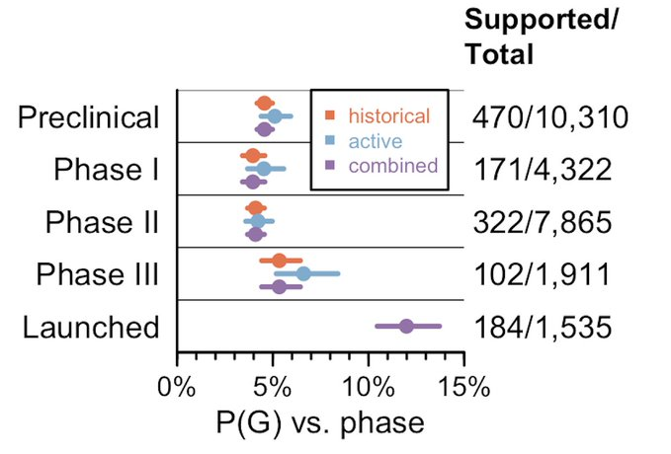
What can GWAS tell us? Pointing us to drug targets
Vallabh-Minkel et al, 2022

Slide 29
What can GWAS tell us? Understanding biology
Most traits are highly polygenic
More than 100 genetic variants associated with schizophrenia, more than 200 with height, more than 500 with cholesterol
Individual genetic variants have small effect sizes
Most causal variation is non-coding

Slide 30
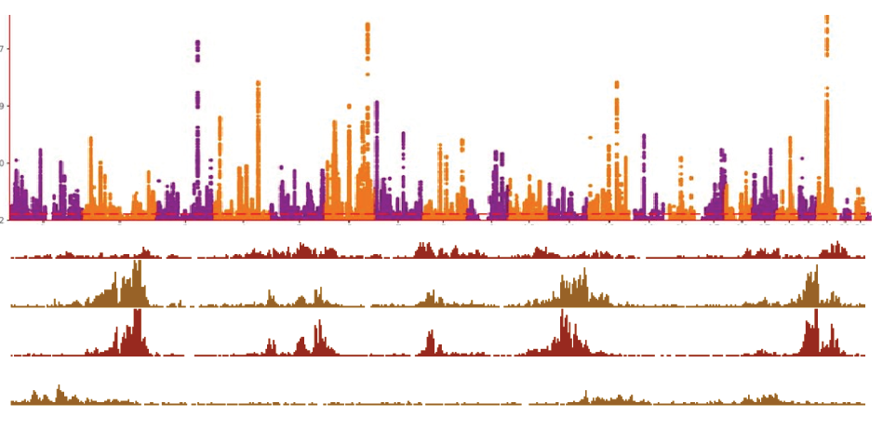
Overlapping GWAS signals with active regions of the genome
Liver
Publicly available gene expression /epigenomic data
Adipose
…
Brain

Slide 31
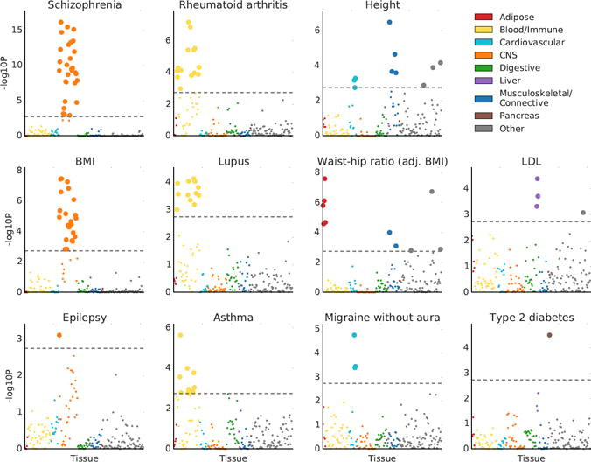
Finucane et al, 2019

Slide 32
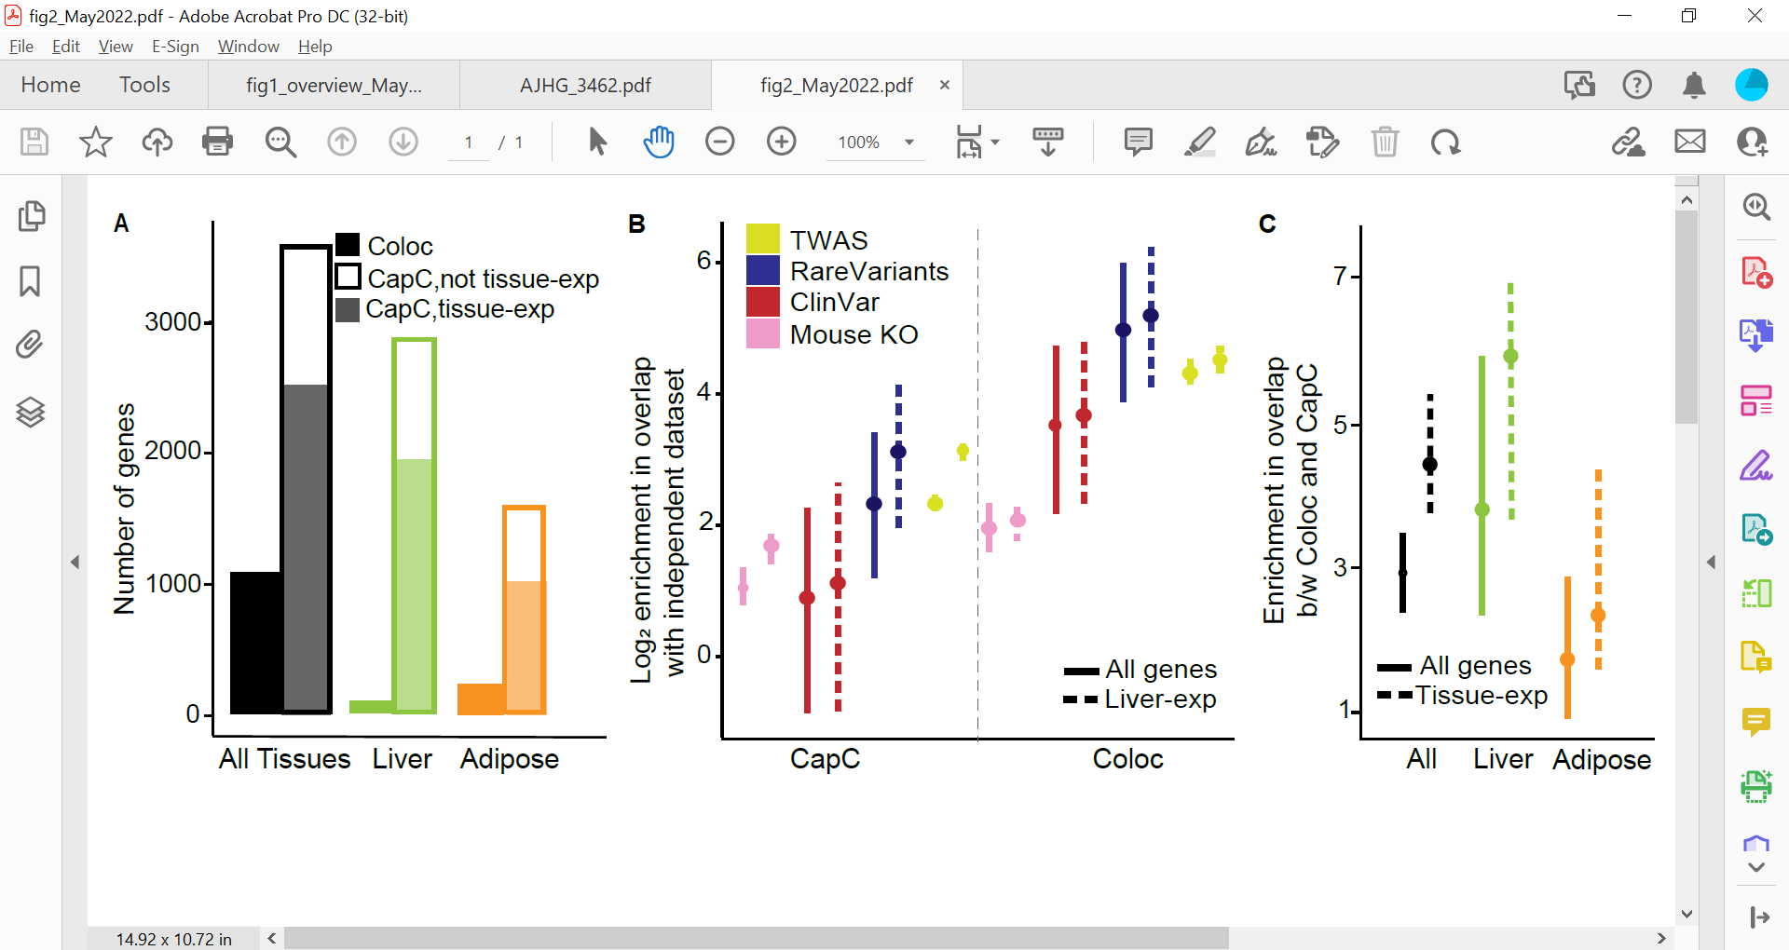
What can GWAS tell us? Relationship between common and rare disease
Allelic series
Common low-effect variants in gene lead to variation in LDL levels
Rare high-effect variants in same genes leads to dyslipidemias

Slide 33
What can GWAS tell us? Relationship between common and rare disease
GWAS to identify common variant modifiers in Mendelian disease

Slide 34
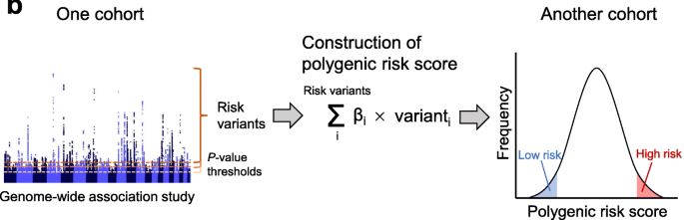
What can GWAS tell us? Polygenic risk scores (PRS)
PRS = Combined genetic risk score from all common risk variants

Slide 35
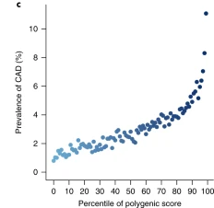
What can GWAS tell us? Polygenic risk scores (PRS)
Individuals in the top 10% of PRS have > 4-fold the risk of heart disease

Slide 36
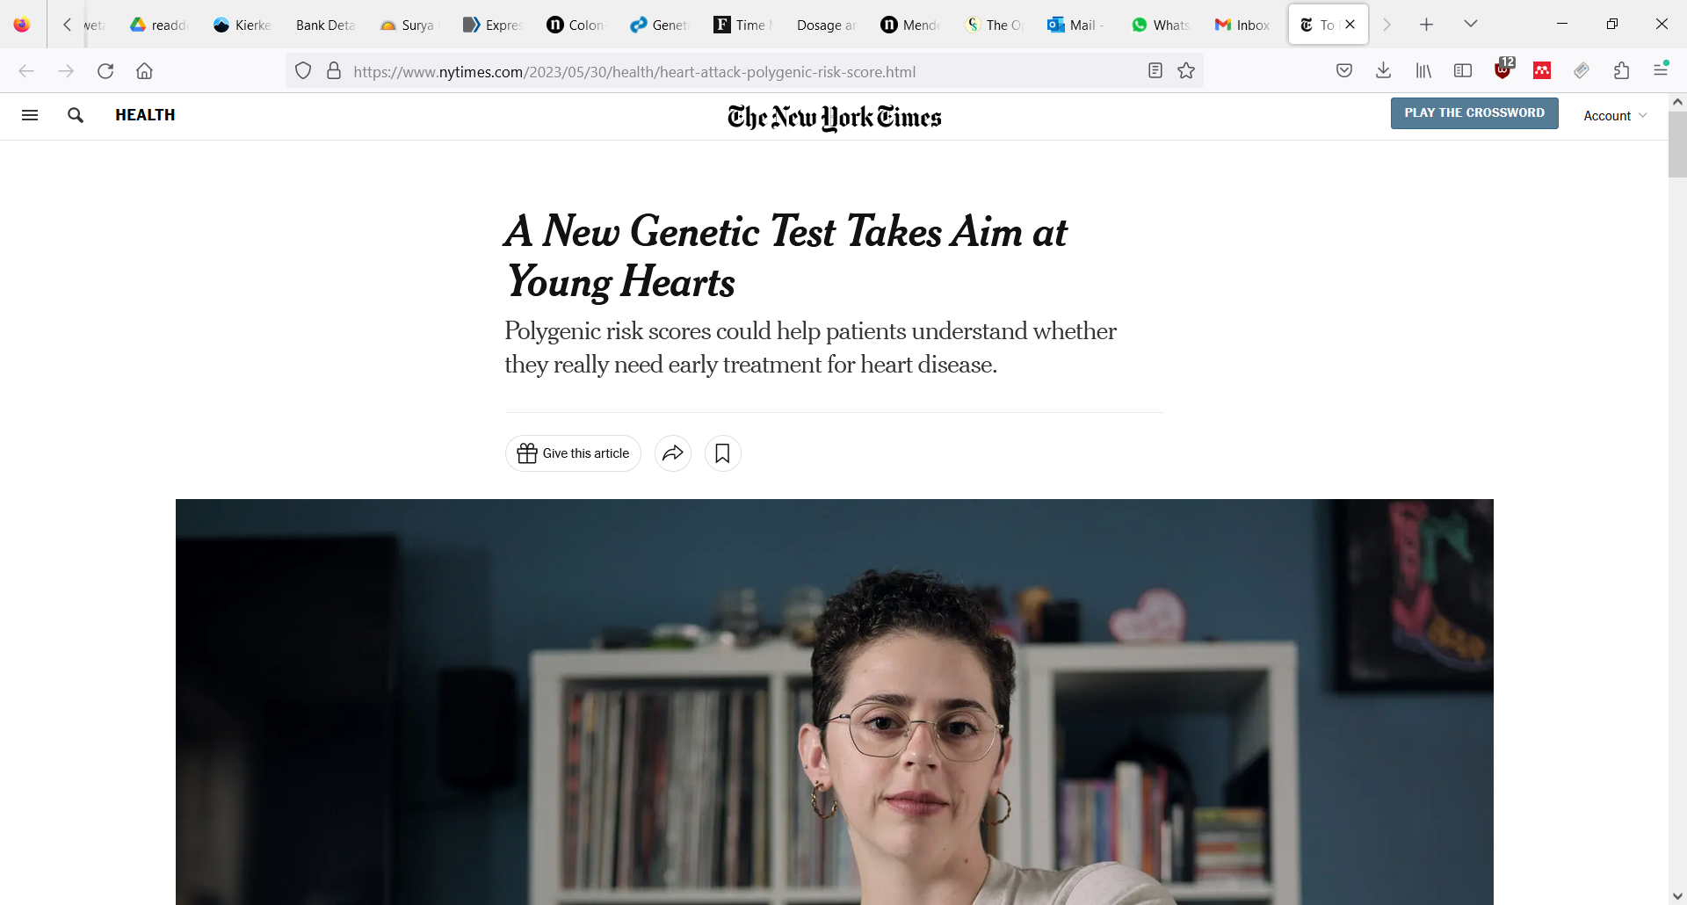
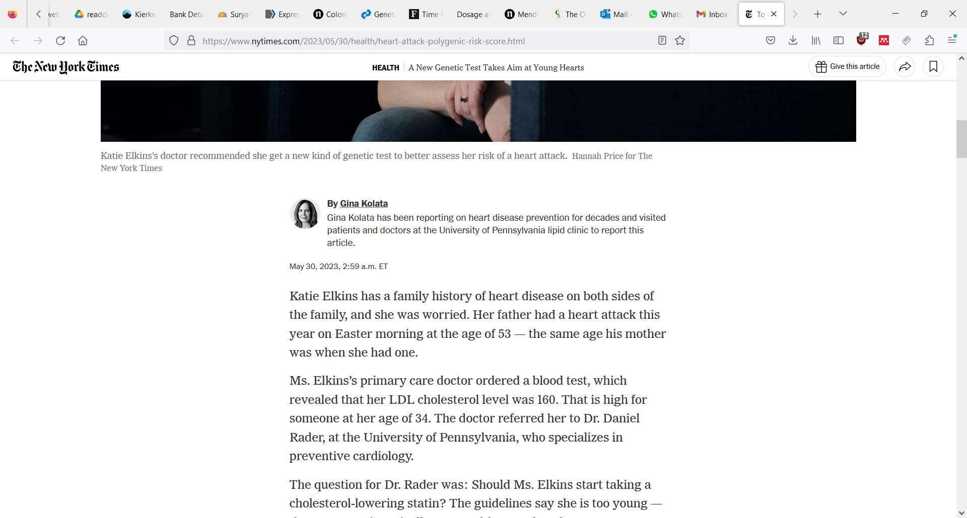
What can GWAS tell us? Polygenic risk scores (PRS)

Slide 37
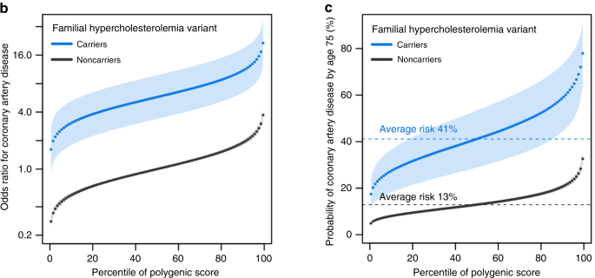
What can GWAS tell us? PRS as modifiers of rare variants (genetic modifiers)
Can help explain reduced penetrance of risk variants for severe disease
Fahed et al, 2023

Slide 38
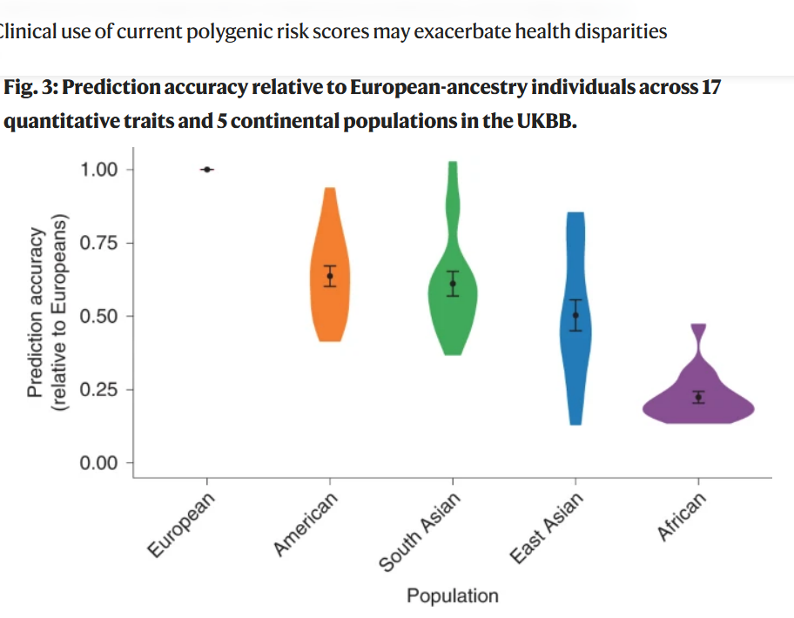
Challenges in GWAS: Transferability of PRS across populations

Slide 39
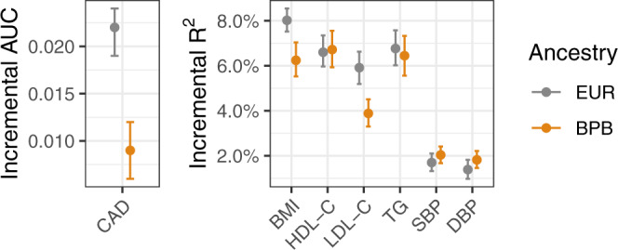
PRS from European populations applied to South Asians
Huang et al, 2022

Slide 40
Differences in linkage disequilibrium could lead to limited transferrability
EUR
IND
Tag SNP

Slide 41
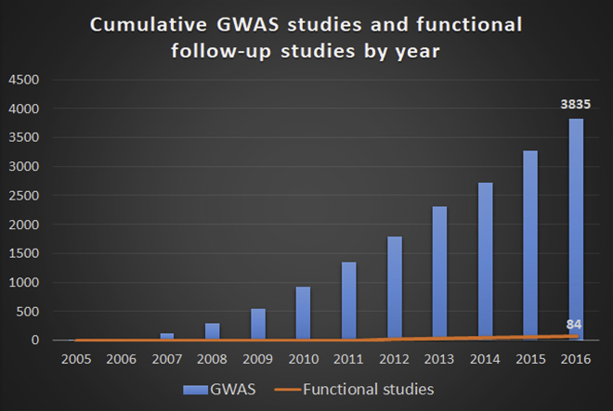
Challenges in GWAS: association to function?

Slide 42
Opportunties for Indian genetics
Very understudied population!
Potential for new discoveries
Increased prevalences of T2D, heart disease…
Unique environments/genetic structure

Slide 43
Utilizing population-based studies to understand common diseases
Shweta Ramdas
Centre for Brain Research (CBR)
shwetaramdas@iisc.ac.in

